Slide 1
Document-Level Event-Argument
Data Augmentation for Challenging Role Types
Joseph Gatto, Omar Sharif, Parker Seegmiller, Sarah M. Preum
ACL 2025
Presenter: Joseph Gatto

Slide 2

What Is Event Argument Extraction (EAE)?
Goal: Given an event-centric text, extract text spans corresponding to event-specific details.
Event Type: Insect Disaster
Event Roles
Influenced Crops and Livelihood
Economic Loss
Response Measures
Aid Agency: UN
Affected Areas: Liberia
Date
Pests: Caterpillars
Cause
Aid Supplies/Amount
Caterpillars in Liberia threaten disaster across region, UN warns.
Pests
Affected Area
Aid Agency

Slide 3
What Is Document-Level Event Argument Extraction (DocEAE)?
Goal: Extract arguments dispersed throughout long documents
Rampaging caterpillars in Liberia threaten disaster across region, warns UN 29 January 2009 A United Nations official has warned today that a UN-led team of experts is in a race against time in its attempt to halt a vast plague of caterpillars, known as armyworms, which has already swarmed across northern Liberia and threatens to march into neighbouring West African countries, destroying all crops and water supplies in its path. The enormous infestation of tens of millions of armyworms, one of the most destructive of insect pests, has forced the Liberian President, Ellen Johnson-Sirleaf, to call a national emergency in a country where access to food is already precarious. “The millions-strong caterpillar hordes devour all vegetation in their path and pollute wells and streams with their excrements wherever they go,” said Representative of the UN Food and Agriculture Organization ( FAO ) in Liberia, Winfred Hammond. Some 100 villages in northern and central Liberia have now been affected and six communities in neighbouring Guinea to the north had also been struck, in some cases overrunning buildings and sending residents fleeing in panic. According to Liberian authorities, the emergency involves about 500,000 villagers. Mr. Hammond warned that much worse could be in store as many of the caterpillars had bored into the ground, out of reach of pesticides, and formed protective cocoons around themselves, waiting to re-emerge as moths in a week or so. “Each moth can fly up to 1,000 kilometers and lay 1,000 eggs,” explained Mr. Hammond, who is an entomologist, stressing that “potentially, that's a recipe for disaster.”
Caterpillars in Liberia threaten disaster across region, UN warns.
Pests
Affected Area
Aid Agency
Sample from DocEE Dataset

Slide 4
Challenges in DocEAE
Challenge 1: Obtaining data for new event types is extremely difficult and expensive.
Source Domain
New Domain
Celebrity Death
Withdraw from an Organization
Investigate Crime
Road Crash
Droughts
Earthquake
Tsunami
Insect Disaster
Need Methods for Improved Low-Resource, Cross-Domain DocEAE!

Slide 5
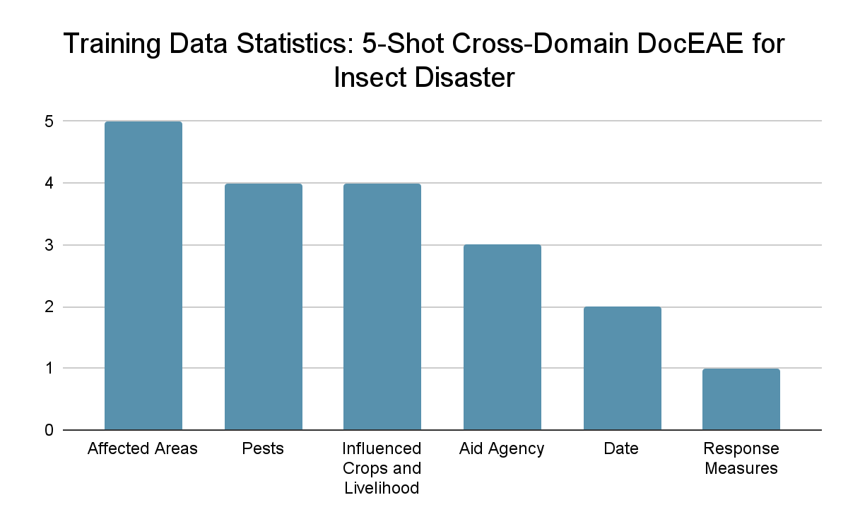
Challenges in DocEAE
Challenge 2: Difficult to model rare role types
Event Type: Insect Disaster
Influenced Crops and Livelihood
Economic Loss: MISSING
Response Measures
Aid Agency
Affected Areas
Date
Pests
Cause: MISSING
Aid Supplies/Amount: MISSING

Slide 6
Solution: Data Augmentation for DocEAE
Past Studies Largely Focus on
Augmentation for Sentence-Level EAE
Augmenting existing samples
Applying pre-trained classifiers to unlabeled corpora
Our Goal
Make LLMs useful for generating DocEAE samples.
Remove dependence on in-domain data
Improve representation of new events and rare role types

Slide 7

LLMs For DocEAE Data Generation
Challenges
Why Don’t LLMs Work Off-The-Shelf for DocEAE Data Generation?
Event Type: Insect Disaster
Influenced Crops and Livelihood
Economic Loss
Response Measures
Aid Agency: UN
Affected Areas: Liberia
Date
Pests: Caterpillars
Cause
Aid Supplies/Amount
Caterpillars in Liberia threaten disaster across region, UN warns.
Pests
Affected Area
Aid Agency

Slide 8
LLMs For DocEAE Data Generation
Challenges
Why Don’t LLMs Work Off-The-Shelf for DocEAE Data Generation?
Prompt
Generate Document with Following Event Structure:
{Pests: Caterpillars, Affected Area: Liberia}
Issue #1: Under Labeling
LLMs are highly likely to generate role information which was not requested!
Caterpillars in Liberia threaten disaster across region, UN warns.
Pests
Affected Area

Slide 9
LLMs For DocEAE Data Generation
Challenges
Why Don’t LLMs Work Off-The-Shelf for DocEAE Data Generation?
Prompt
Generate Document with Following Event Structure:
{Pests: Caterpillars, Affected Area: Liberia, Aid Agency: United Nations}
Issue #2: Trouble Generating Substrings
We need to generate a document suitable for an extractive task! LLMs struggle to follow such instructions.
Caterpillars in Liberia threaten disaster across region, UN warns.
Pests
Affected Area

Slide 10
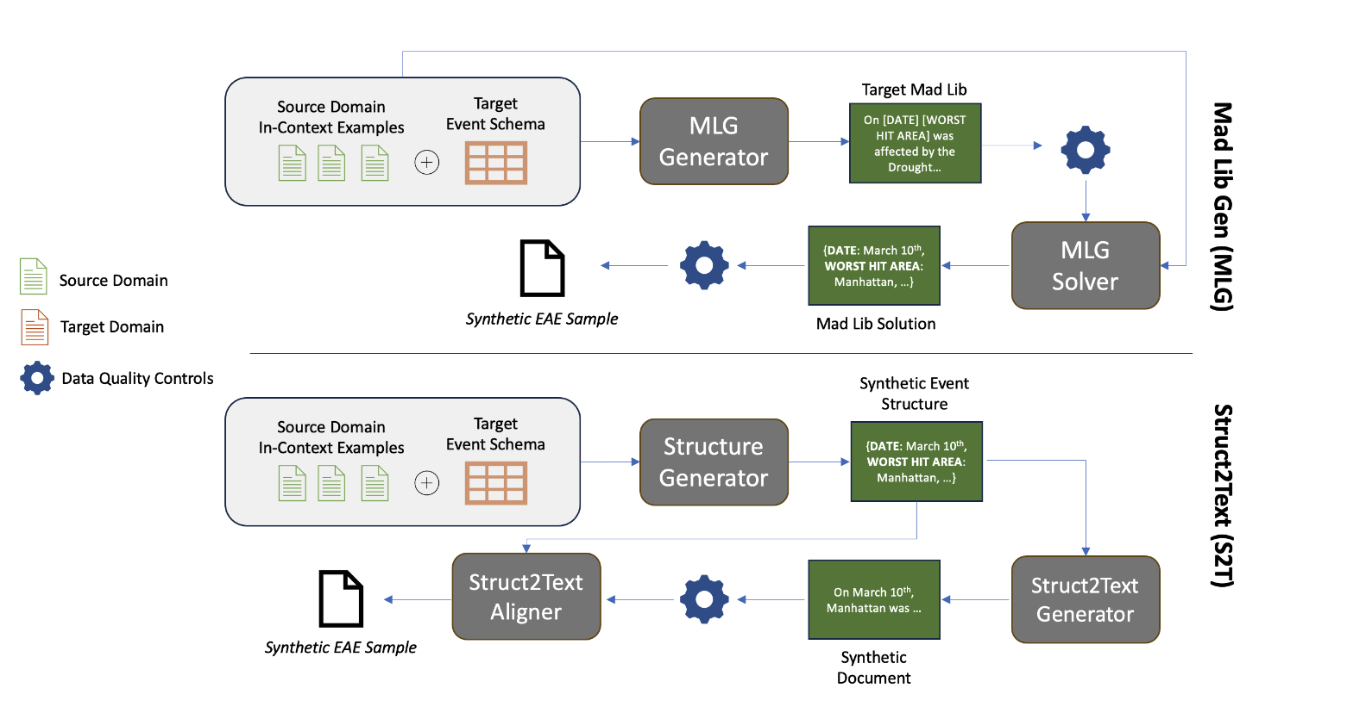
Generating Synthetic Data

Slide 11
LLMs For DocEAE Data Generation
Solution #1: Templated Document Generation (Mad Lib Gen)
MadLib
Event Type
Event Schema
a[Pests] in [Affected Area]
threaten disaster across region
Stage 1: Templated Document Generation
a[Aid Agency] warns
MadLib
pests: Caterpillars,
Affected area: Liberia,
Aid agency: UN
{
Solution
Out-of-Domain Examples
Solution
{role:arg
role:arg}
Stage 2: Slot-Infilling
MadLib
Mad Lib Generation and Solving

Slide 12
LLMs For DocEAE Data Generation
Solution #1: Templated Document Generation (Mad Lib Gen)
MadLib
We solve Under Labeling by providing the full event schema during generation
We solve generation for span extraction by created templated documents which can be string replaced for document construction
a[Pests] in [Affected Area]
threaten disaster across region
a[Aid Agency] warns
pests: Caterpillars,
Affected area: Liberia,
Aid agency: UN
{
Solution
Mad Lib Generation and Solving

Slide 13
LLMs For DocEAE Data Generation
Solution #2: Struct-to-Text Generation with Span Realignment
pests: Caterpillars,
Affected area: Liberia,
Aid agency: UN
{
Event Type
Event Schema
Stage 1: Structure Generation
Synthetic Structure
Out-of-Domain Examples
Caterpillars in Liberia threaten disaster across region, UN warns.
Synthetic Structure
Synthetic Document
Stage 2: Struct-to-Text
Struct2Text Generation

Slide 14
LLMs For DocEAE Data Generation
Solution #2: Struct-to-Text Generation with Span Realignment
pests: Caterpillars,
Affected area: Liberia,
Aid agency: UN
{
Butterfly larva in Liberia threaten disaster across region, United Nations warns.
Aligner
Stage 3: Text-Structure
Alignment
Synthetic Document
Synthetic Structure
{
pests: Butterfly larva,
Affected area: Liberia,
Aid agency: United Nations
Aligned Structure

Slide 15
Experiments
Task: Few-Shot, Cross-Domain DocEAE
Dataset: DocEE
Example Source Domain Events:
Archeological Discoveries
Famous Person - Give a Speech
Organization Merge
Target Domain Theme: Natural Disasters (E.g. Earthquakes, Tsunamis)
Split | # Samples | # Events
Source Train | 23,630 | 49
Target Train | 50 | 10
Target Dev | 1,850 | 10
Target Test | 1,955 | 10
1
DocEE Dataset Statistics
1. DocEE: A Large-Scale and Fine-grained Benchmark for Document-level Event Extraction (Tong et al., NAACL 2022)

Slide 16
Experiments
Stage 1: Pre-Train on Source Domain
Source Domain Data
(23k docs, 49 events)
Model
Stage 2: Fine-Tune on Target Domain
Target Domain Fine-Tuning
(5-shot)
Model
Synthetic Data

Slide 17
Evaluation Metrics
Model Output = (Document ID, Role, Argument)
Metric | Description
F1 | Standard F1 On All Data
Role F1 | Compute F1 For Each Role Individually, Then Take Average
0-Shot F1 | Role F1 for 0-Shot Roles (n=9)
Role-Depth F1 (RDF1) | Role F1 for Semantically Outlying Roles (n=16)

Slide 18
Baselines
Baselines Models
BERT-QA: BERT-based Span Extraction
GPT-4o: LLM Prompting for EAE
Our Methods
Mad Lib Gen (MLG): GPT-4o backbone
Struct2Text (S2T): GPT-4o backbone
*Please see our paper for results on additional models!

Slide 19
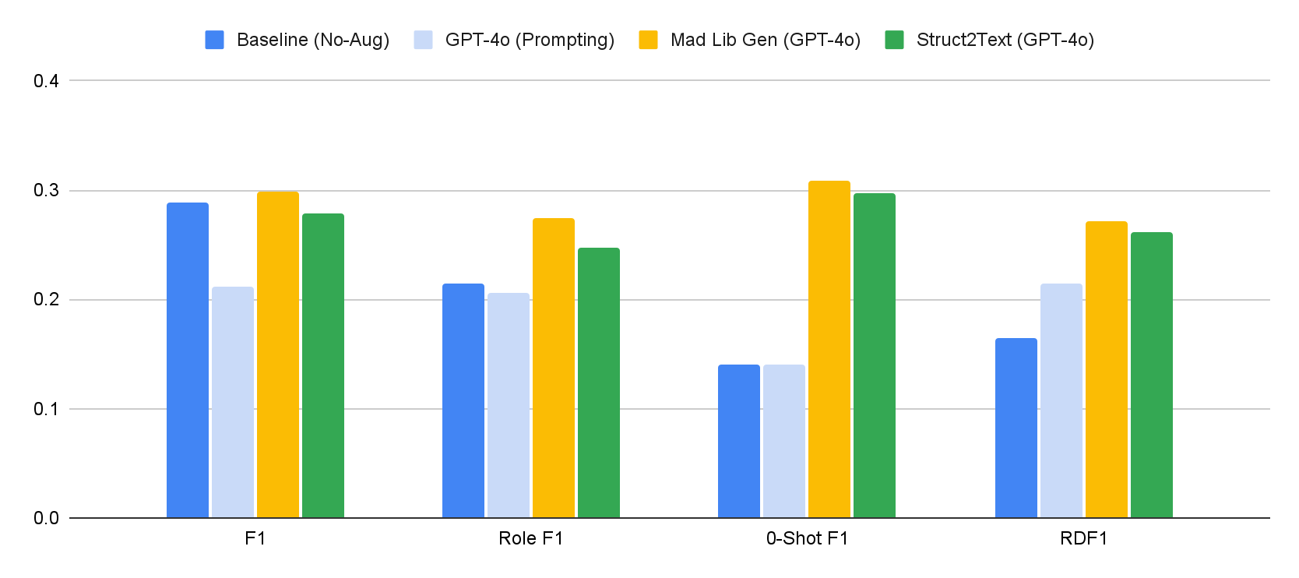
Results: BERT-QA
Baselines
Our Methods!

Slide 20
Results: BERT-QA
Result #1: Both Mad Lib Gen and Struct-to-Text significantly improve performance on zero-shot and RDF1 roles.

Slide 21
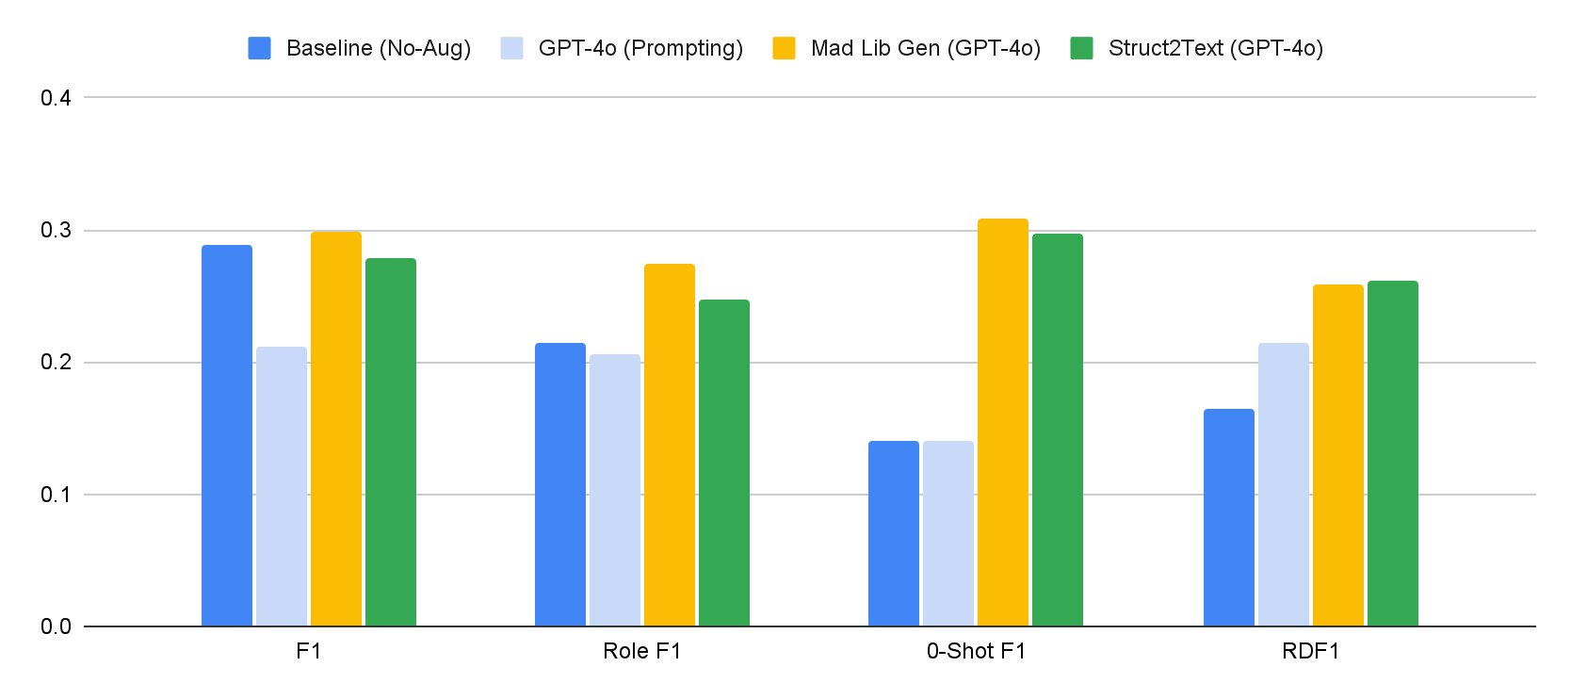
Results: BERT-QA
Result #2: Trade off between overall-performance and mean role performance
Cause: Balancing role distribution removes ability to overfit to common role types!

Slide 22
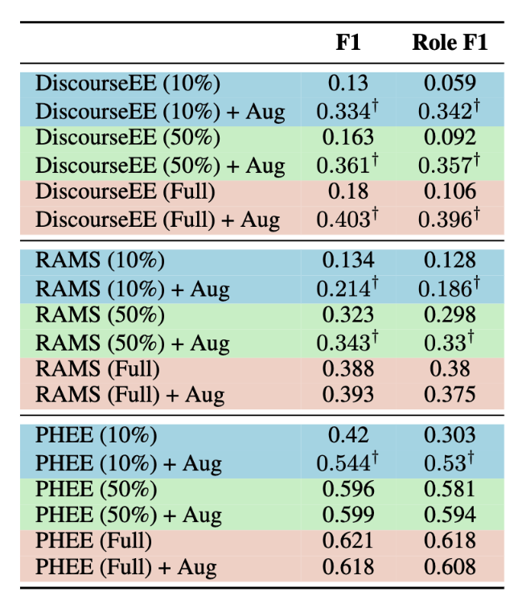
Results: MLG Boosts Performance on Other EAE Datasets!
Result #3: MLG augmentation boosts performance in low-resource settings on other tasks!
Table: BERT-QA results showing performance with and without 500 synthetic samples + x% of training data for each of DiscourseEE, RAMS, and PHEE.

Slide 23
Conclusion: MLG vs S2T → Which to use?
Mad Lib Gen (MLG)
Benefits
More open-source friendly. Works with smaller LLMs!
More accurate span annotations.
Limitations
Difficult to include additional event information.
Struct2Text (S2T)
Benefits
Straightforward to include additional event information!
Limitations
Relies on Langchain + OpenAI Pydantic integration. Not small-LLM friendly.

Slide 24
Thank You!
Document-Level Event-Argument
Data Augmentation for Challenging Role Types
Joseph Gatto, Omar Sharif, Parker Seegmiller, Sarah M. Preum

